Slide 1
Note: This PPT is “view only”
To make a copy that allows edits, please click here: https://docs.google.com/presentation/d/1eWUJQV1K6UmmkmT0RpdBOvhZTa_HbMan/copy

Slide 2
Guide to National Board Certification

Slide 3
Welcome! Please introduce yourself
Please share:
Your name
Your school
Your subject area
Either:
A celebration (personal or professional) from this week
Something you hope to learn from today’s session

Slide 4

Agenda
Program Overview
What is National Board?
Process and Components
Learning More
The Candidate Experience
Impact data; what is your why?
Getting Started
What are your next steps?
Consider your decisions, find local support, and access National Board resources

Slide 5
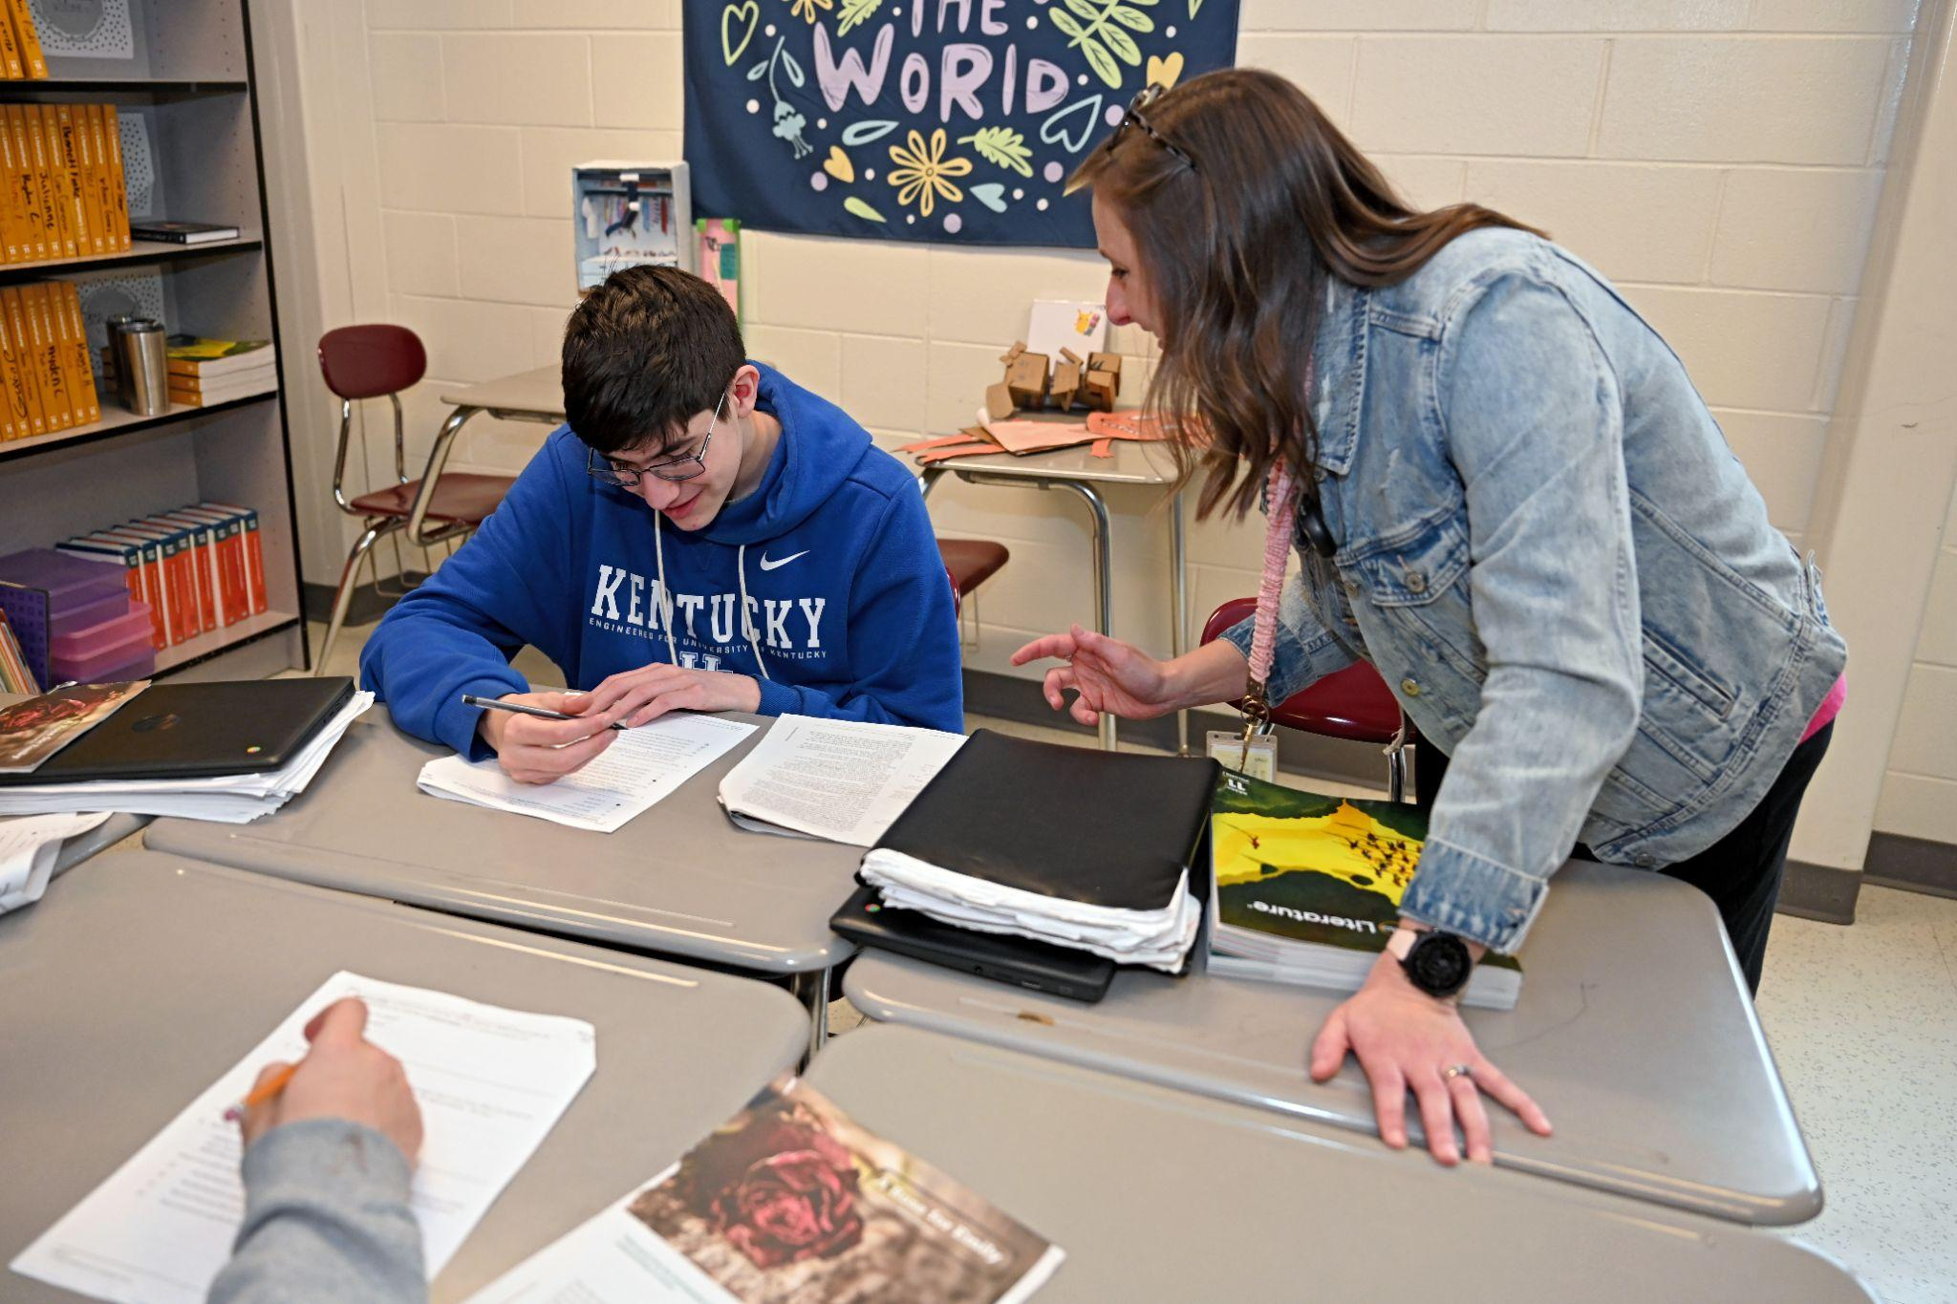

01
Overview

Slide 6
What is National Board Certification?
National Board Certification is a 5-year teaching certification recognized across the nation as representative of accomplished teaching practice.
The process is entirely voluntary, and teachers and school counselors, may begin the process at any point in their career, but must have completed three years of experience in order to achieve National Board Certification.
This certification was created by teachers, for teachers; and educators are involved in all aspects of the assessment to make sure this process reflects what you do in the classroom or in your role with students.
Think of this as professional development that is FOR YOU in this moment in your career.

Slide 7
Who is Eligible for National Board Certification?
To become a National Board candidate, educators must meet the following eligibility criteria:
Hold a Bachelor’s Degree, or higher.
A candidate can start the National Board process at any point in their career, but they must have completed at least three years of teaching or school counseling in order achieve National Board Certification.
Possess a valid State or School Counseling License (or taught on an area where a license is NOT required ex. CTE)
Questions about eligibility: Call 1-800-22TEACH (83224) or visit https://www.nbpts.org/certification/get-started/

Slide 8
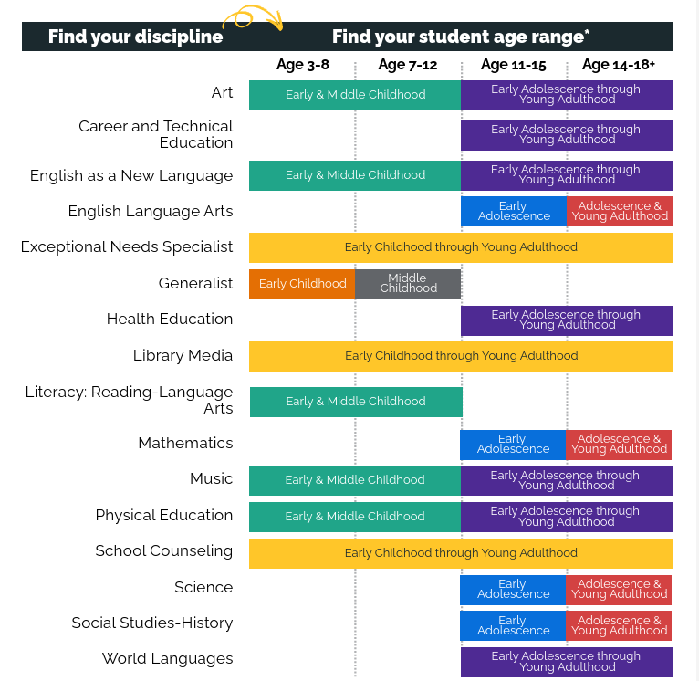
Certification Areas
National Board Certification is available in 25 certificate areas representing 16 different disciplines and four developmental levels.
A guide to finding the right certificate for candidates can be found here:
Choosing the Right Certificate: Information by Certificate Area

Slide 9

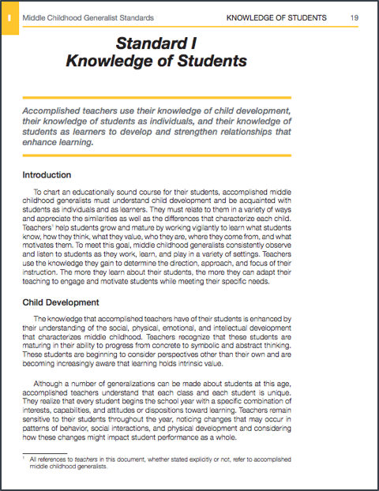

Key Documents of NB Certification
Five Core Propositions
Content-Specific Standards
Architecture of
Accomplished Teaching

Slide 10
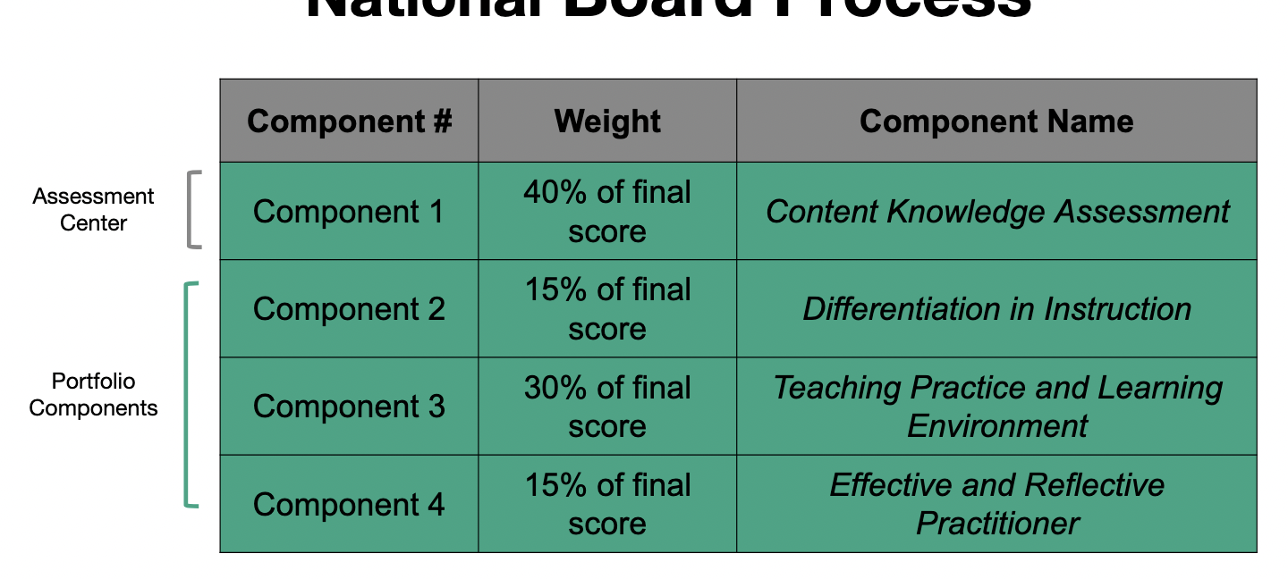
National Board Scoring
Learn more about National Board Scoring here or watch this short clip.

Slide 11




Steps to Certification
The process to becoming certified includes candidates completing four components to demonstrate accomplished practice:
Component 1: Content Knowledge
Component 2: Differentiation in instruction
Component 3: Teaching practice and learning environment
Component 4: Reflective Practice
Each certificate area has specific instructions on what these components entail. Candidates must attempt each of the four components within the first three years of their candidacy. Candidates can also retake specific components up to two times to try and improve their score. However, the entire process must be completed within five years.

Slide 12

Component 1: Content Knowledge
Measures developmentally appropriate content knowledge and pedagogical practices in the chosen certificate area:
Traditionally taken in the spring.
Component 1 is made up of two assessments:
  Three constructed (long-form) response items
-30 minutes to complete each
  And 45 selected response (multiple choice) items
-Time allotted varies by certificate, but no fewer than 60 minutes
Accommodations are available and required prior to arriving at the testing center

Slide 13
Component 2: Differentiation in Instruction
Highlights ability to evaluate learning strengths and needs for individual students; plan and implement appropriate instruction.
Classroom-based portfolio entry:
  Sample of student work that demonstrate the student’s growth over time
  Accompanying written commentary that analyzes your instructional choices
Collect evidence any time between now and mid-May submission deadline
Tip: Collect samples of work early and often so you have plenty of work to choose from. Start at the beginning of the year!

Slide 14
Component 3: Teaching Practice & Learning Environment
Highlights how candidates engage students and impact their learning
Video recordings of interactions between candidates and their students
Two written commentaries, in which the candidate describes, analyzes and reflects on their teaching and interactions
Collect evidence anytime now to mid-May submission
Tip: Begin recording (or practicing recording) early and often so you have plenty of work to choose from. Start at the beginning of the year!

Slide 15
Component 4: Effective & Reflective Practitioner
Highlights understanding of assessments and assessment practice/data collection to plan for and positively impact student learning
Demonstrating practices with a rostered class of students
Evidence of collaboration with families, communities, and colleagues
Contributions to professional learning communities to advance student growth
Collect evidence anytime now to mid-May submission
Tip: Create a folder with emails about collaboration with families, communities, and colleagues

Slide 16
Maintenance of Certification
The National Board’s Maintenance of Certification (MOC) is the pathway for National Board Certified Teachers (NBCTs) to keep their certification active.
National Board Certification lasts for five years. To maintain certification, candidates will go through the Maintenance of Certification process. MOC supports and information can be found on the National Board website.

Slide 17

Certification Cost
Each of the four components costs $475, with the total certification costing $1,900. Candidates can pay for and submit each component individually, spreading the cost out over three years.
There is a $75 non-refundable registration fee for each year a candidate completes components.
Candidates who choose to retake components must pay the $475 fee or, for Component 1, pay $125 per exercise and/or the Selected Response section.
The Maintenance of Certification costs $495 plus a $75 registration fee.

Slide 18
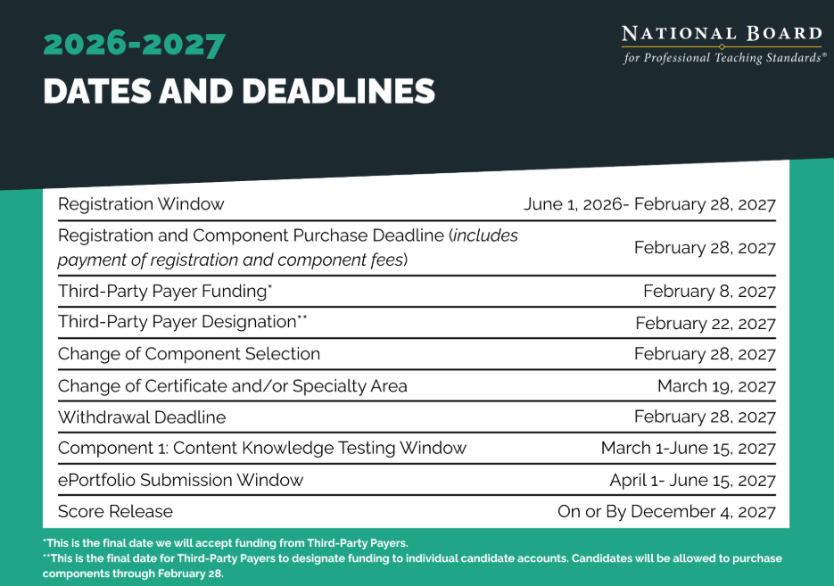
Important Dates & Deadlines

Slide 19
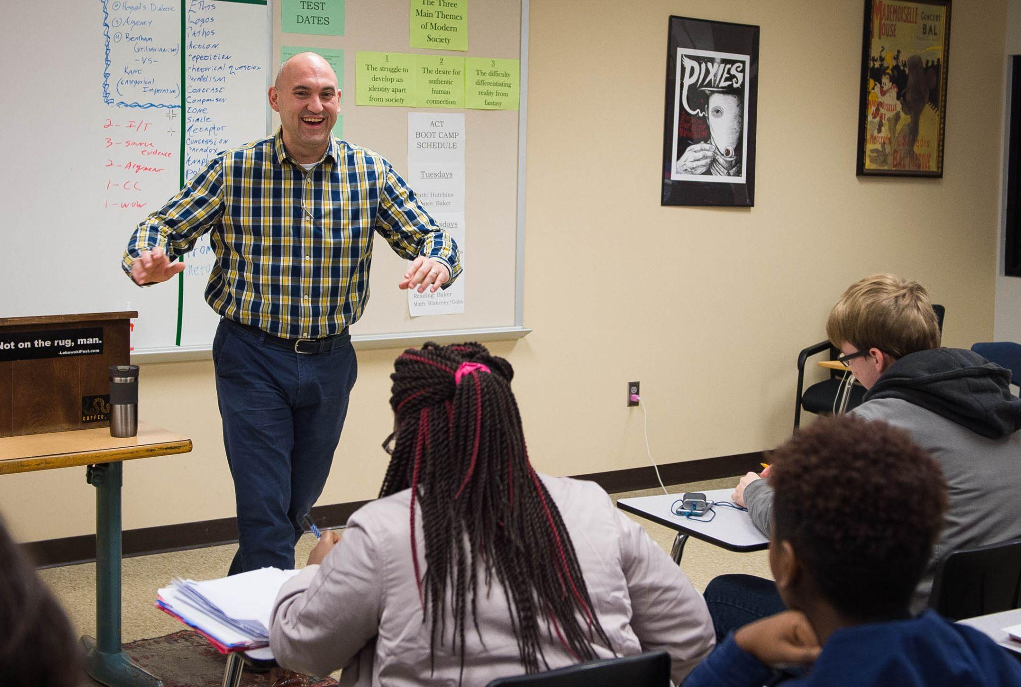

02
Candidate Experience

Slide 20
Kentucky Incentives for National Board Certification
Salary Bonus: NBCTs in Kentucky receive an annual $2,000 salary bonus for the life of their certificate, which also factors into retirement.
Rank Change: New NBCTs in Kentucky with Rank 3 certification can apply to the state EPSB for a permanent change to Rank 2, and NBCTs with rank 2 can apply for a permanent change to rank 1.
Please note:
If a candidate decides not to maintain their certification at the end of the five-year period, they will lose the salary bonus but maintain the rank change.
In accordance with KRS 157.395, “If a nationally certified teacher becomes no longer employed as a classroom teacher or a teacher mentor in the field of his or her national certification, the $2,000 supplement shall cease.”

Slide 21
Why do Educators Pursue National Board Certification?
What’s in it for me?
Internal Reward
91% of all National Board Certified Teachers (NBCTs) have said that the process has made them a better teacher.
The vast majority of NBCTs have said this process is the best professional development they’ve ever done.
Studies have shown that retention rates and job satisfaction data are higher for NBCTs than for non-NBCTs.

Slide 22
Impact on Students
Impact on Early Childhood Learning
Data shows the impact of National Board certified teachers on students in the early years of their education.
Early childhood students taught by an NBCT reading instructor are 31% more likely to score higher on literacy assessments than other students.
3rd grade students taught by an NBCT are 11% more likely to achieve a proficient score on the MAP Test in English Language arts than other students.

Slide 23
Impact on Students Continued
Impact on Overall Learning
Data shows the impact of National Board certified teachers on students.
Harvard University’s Strategic Data Project reported that students of Board-certified teachers in the Los Angeles Unified School District gained roughly the equivalent of two months of additional instruction in Math and one month in English Language Arts.
A study from the state of Washington showed that students gained 1.5 additional months of overall learning when taught by a NBCT.

Slide 24
Quotes from KY NBCTs
National Boards allowed me to reflect on what is most important to me as an educator. As I watched back my recordings, I saw many opportunities to improve a lesson or to slow down and listen more to my students. We work in very fast paced settings, but the thing I learned most from the certification process is the importance of getting to know my students and learning along with them.
- Ashleigh Glickley, Jefferson County
Becoming National Board Certified changed the way I look at my teaching. I plan with more purpose, I reflect more, and I’m more aware of why I make certain choices in the classroom. It also opened a lot of doors for me to mentor other teachers and take on leadership roles.
- Zach Parsons, Russell Independent
National Board Certification has profoundly shaped my work as an educator. The process pushed me to become far more reflective and analytical in my instructional decision-making, which has elevated the quality and intentionality of my practice.
- Erin Peach, Frankfort Independent

Slide 25


03
Getting Started

Slide 26
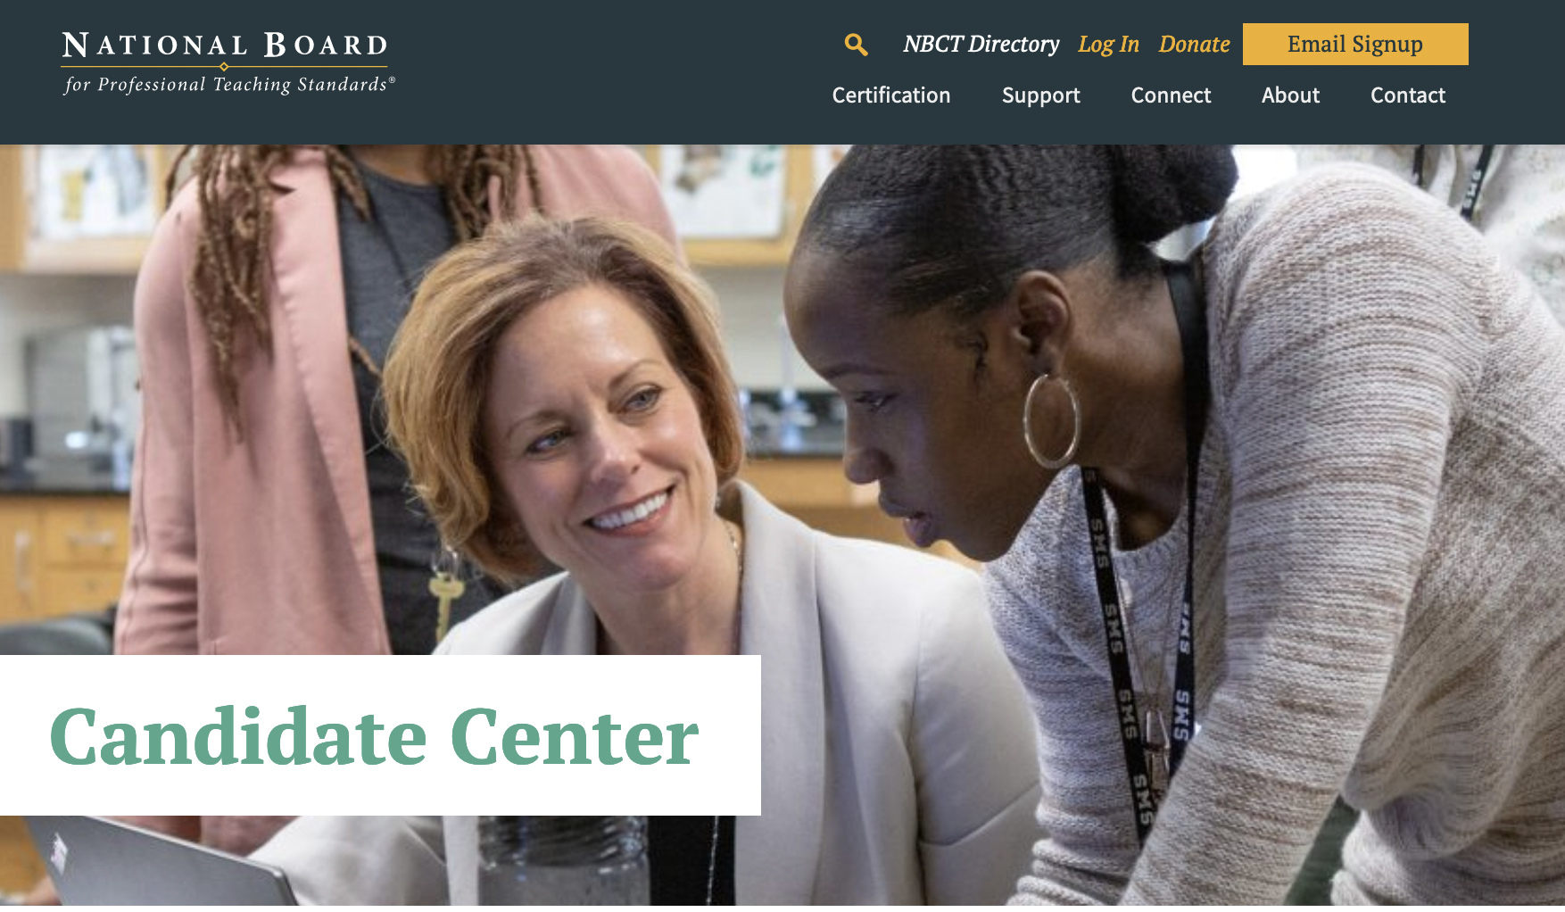
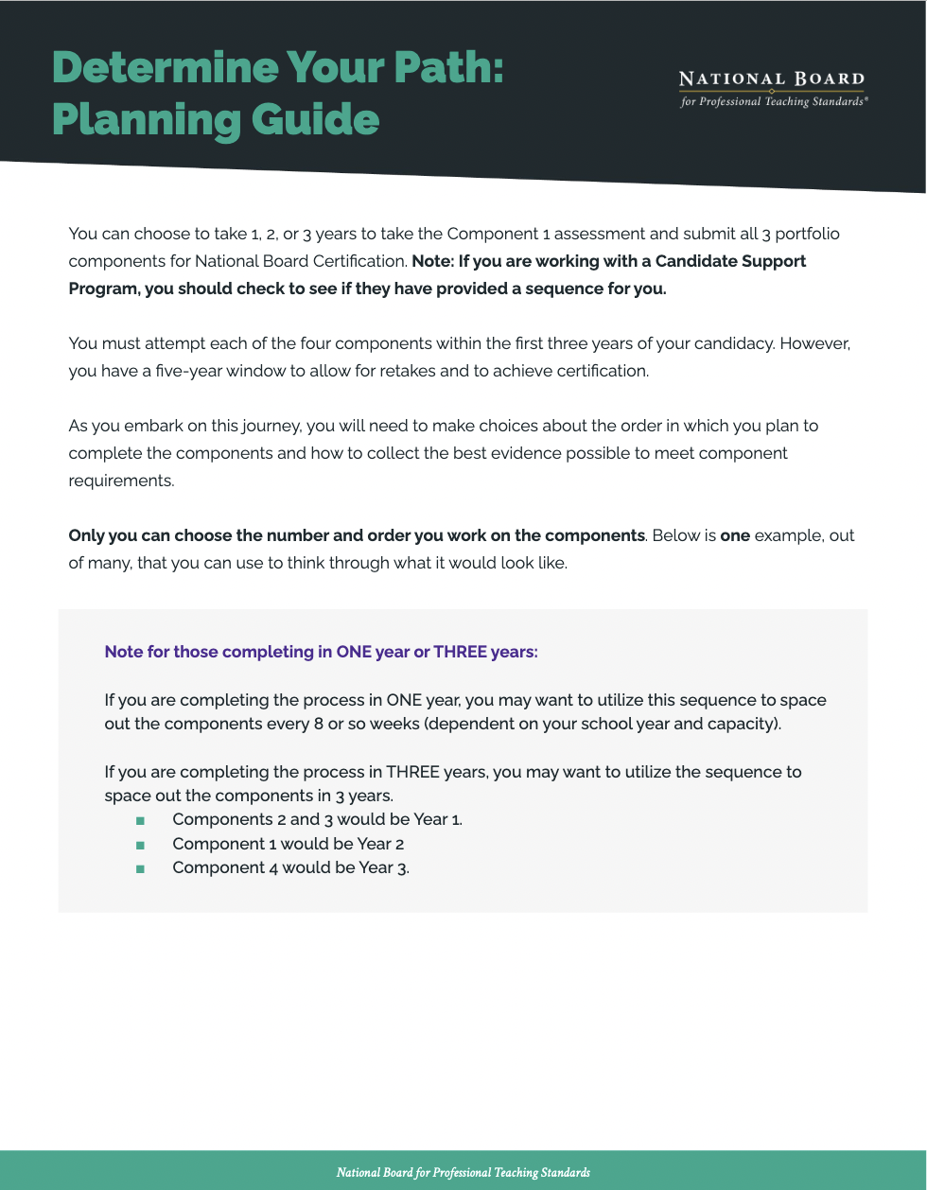
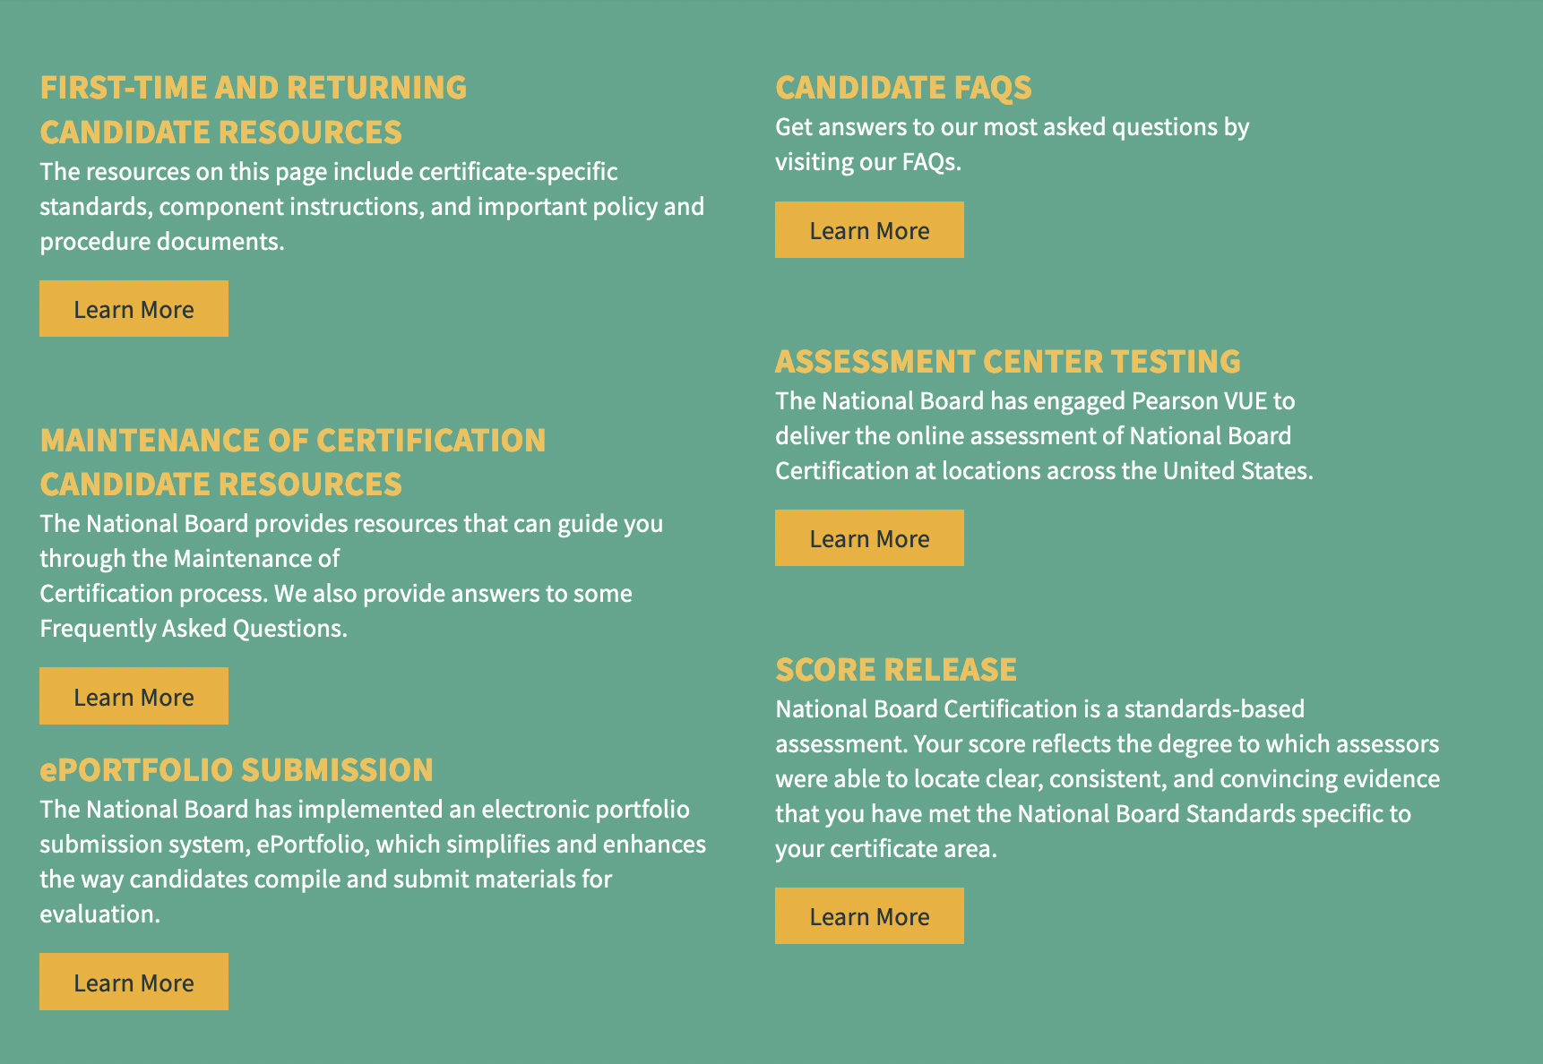
Explore the Resources Available
Candidate Center
Planning Guide

Slide 27
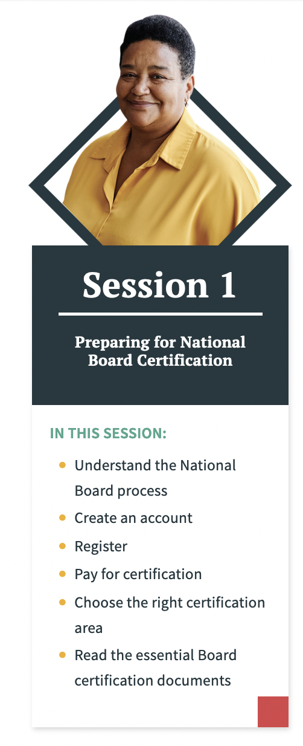
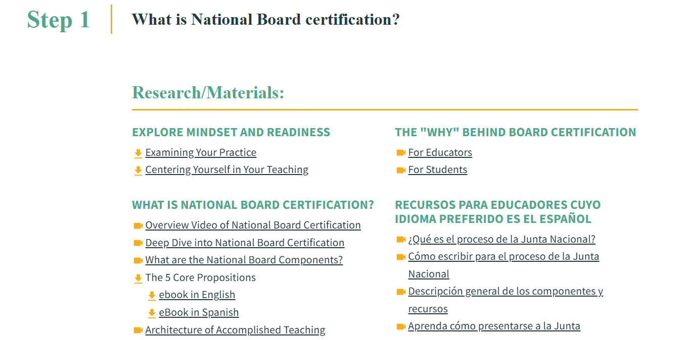
Homeroom
http://www.nbpts.org/homeroom

Slide 28
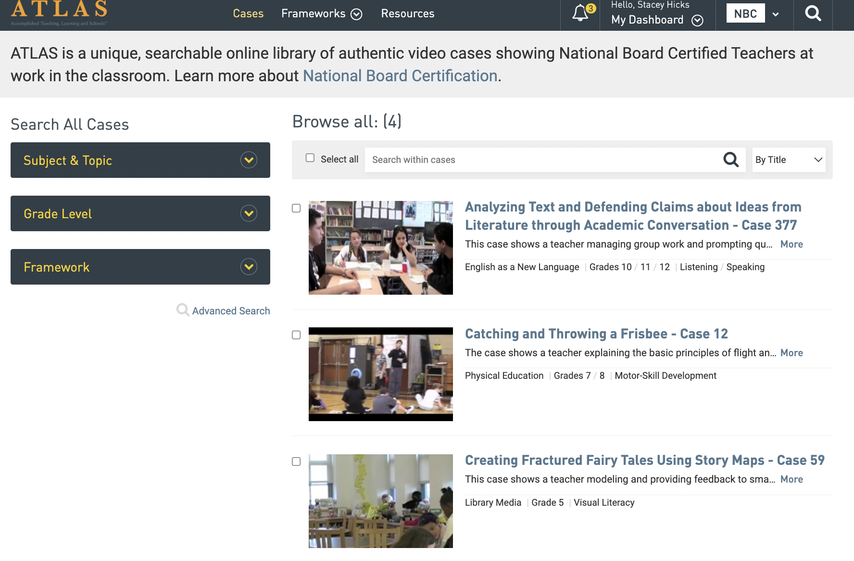
ATLAS
Digital library of authentic, unedited video cases showing accomplished teachers in the classroom
Vetted video cases representing the highest-scoring entries submitted by candidates
All National Board candidates receive FREE access to up to 25 cases during their candidacy..!
http://www.nbpts.org/atlas

Slide 29
Kentucky NBCT Network
https://kynbctnetwork.weebly.com/
Lifetime membership for $25
Membership benefits:
Opportunities to network with like-minded NBCTs in Kentucky and across the country
Leadership opportunities and ways to grow and stretch beyond certification
Access to high quality resources
Access to NBCT mentor list (mentors set individual fees)
​Cool #NBCTStrong Swag
A chance to make a real difference in improving education for ALL Kentucky public school students

Slide 30
Action Items
Determine your Certificate Area
  16 disciplines, across 4 age ranges
Determine your path
  1, 2, or 3 years to complete components
Select your components
  Learn and plan for each component
  Begin gathering data and evidence
  Use Homeroom as a guide
Create an account and purchase your components
Find a support network
  Join the KY NBCT Network, determine if you district has a mentoring cohort, encourage colleagues to go through the process with you, seek advice from NBCTs in your district or discipline using the NBCT directory.

Slide 31
Questions?
Email nbct@education.ky.gov

